Slide 1
SnapDragon
T.Dharani (1818113)
K.Sowndarya(1818153)

Slide 2
Exp no:12 Shortest path using Dijkstra’s algorithm
AIM:
To implement the Dijkstra’s algorithm using
shortest path between the routers using python.

Slide 3
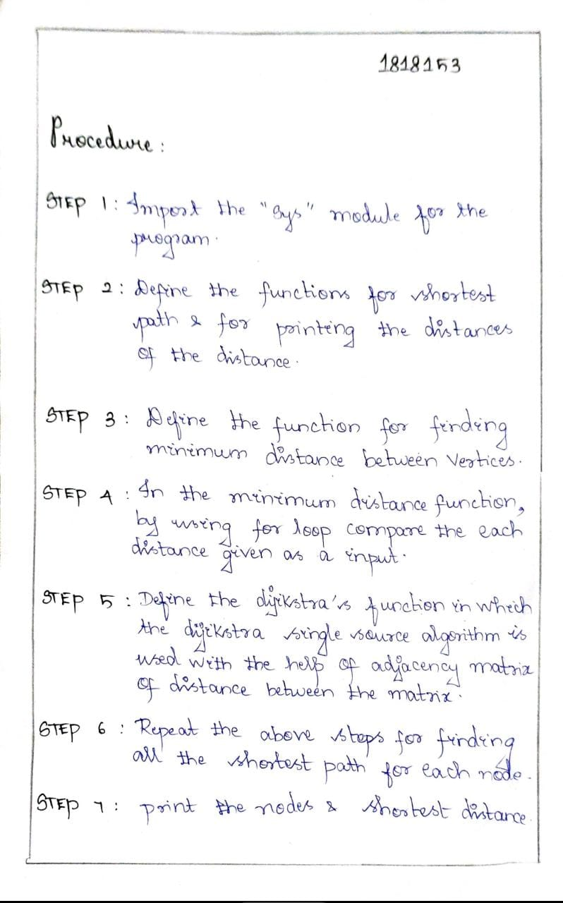
Procedure:

Slide 4
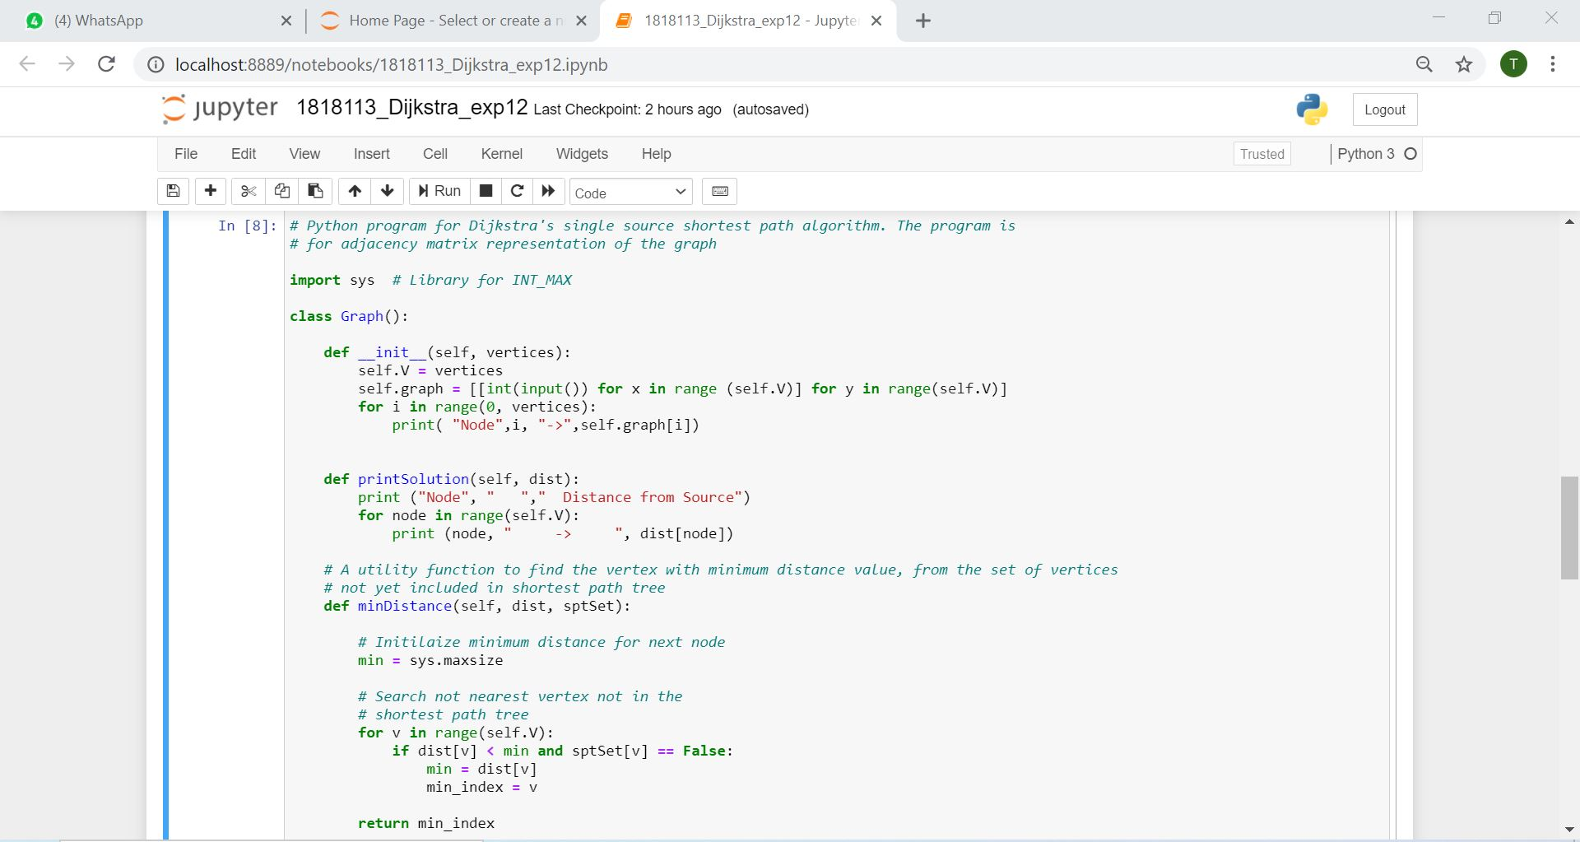
Program:

Slide 5
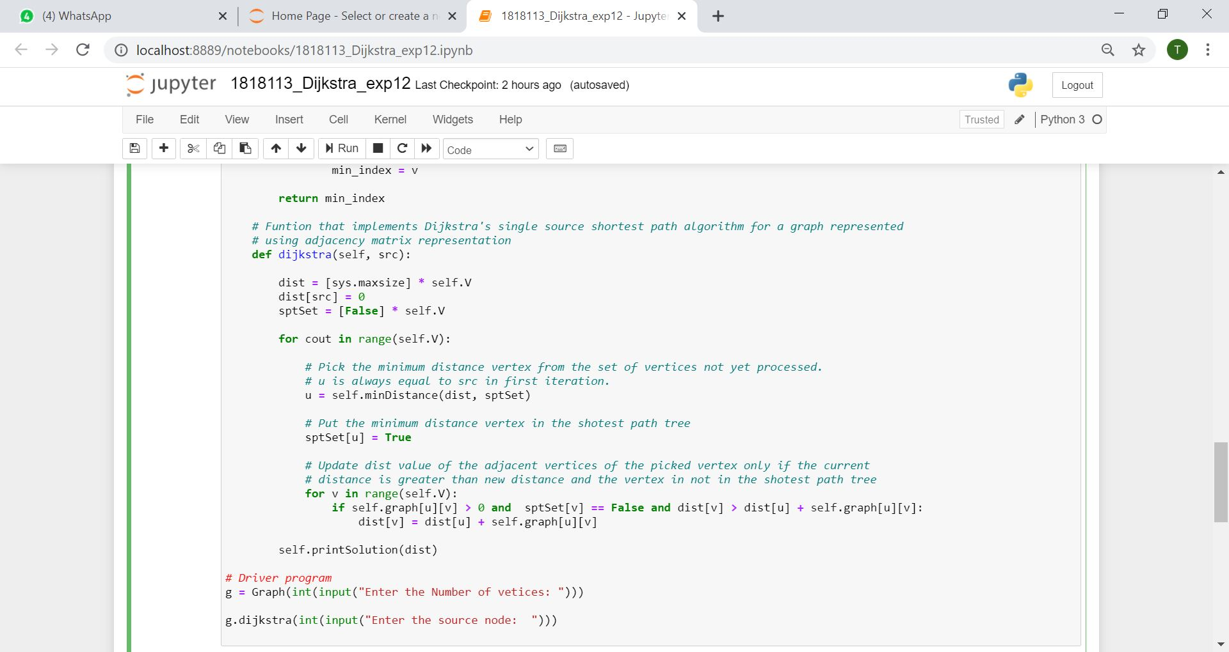

Slide 6
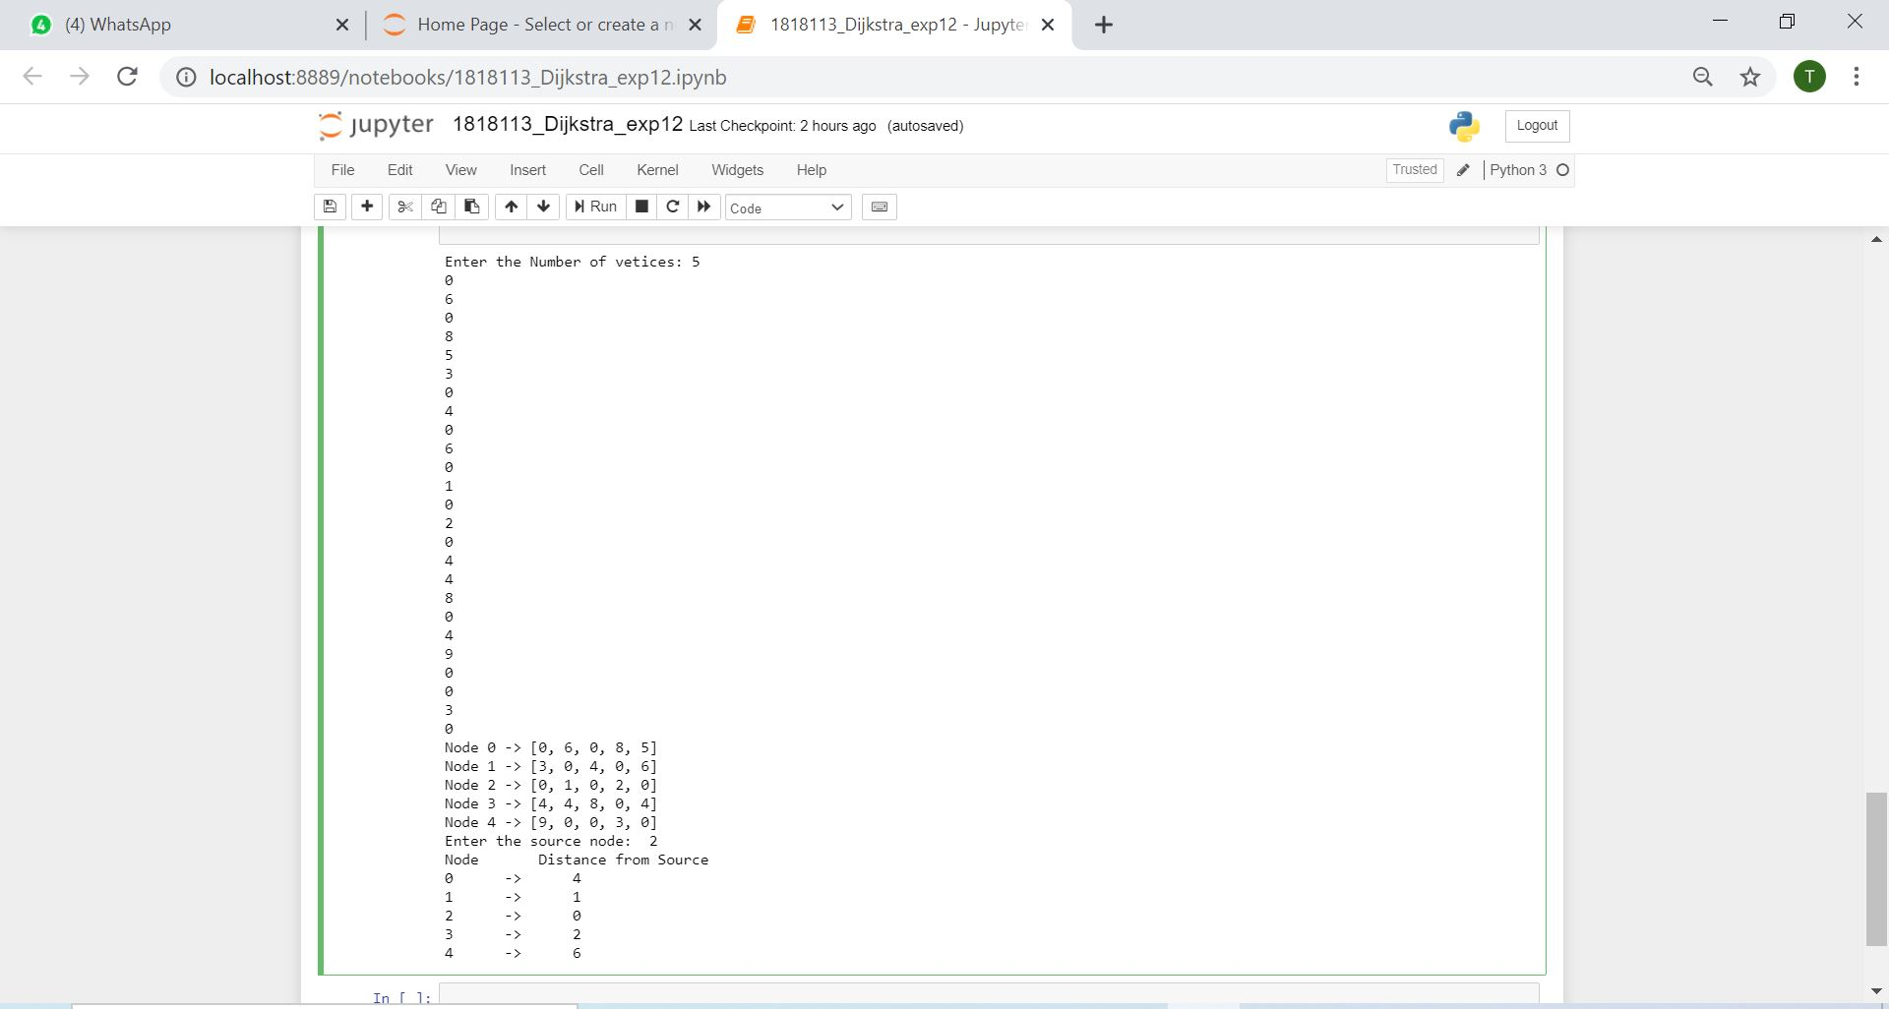
Output:

Slide 7
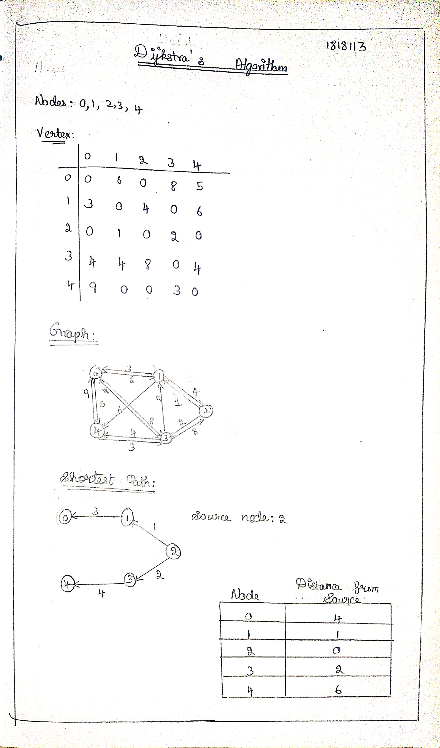
Tracing:

Slide 8
RESULT:
Thus, the shortest path of the graph was found
by using Dijkstra’s Algorithm in python program.

